Slide 1
Recent Works on Noisy Labels Robustness
By Kaiyi Huang

Slide 2
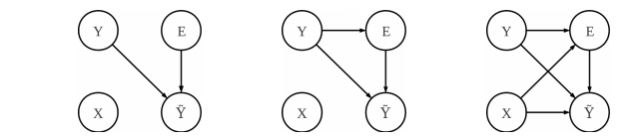
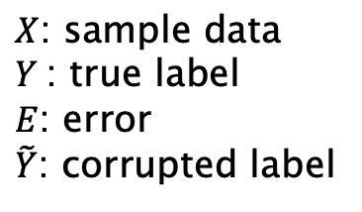
Three Types of Noisy Labels
$X$: sample data
$Y$: true label
$E$: error
$\tilde{Y}$: corrupted label
Frénay & Verleysen, 2013:
Left: uniform noise
Middle: class-dependent asymmetric noise
Right: asymmetric noise related to features and true label (unexplored)

Slide 3
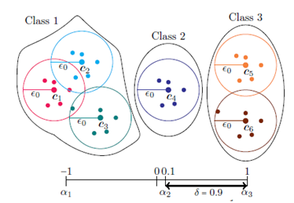
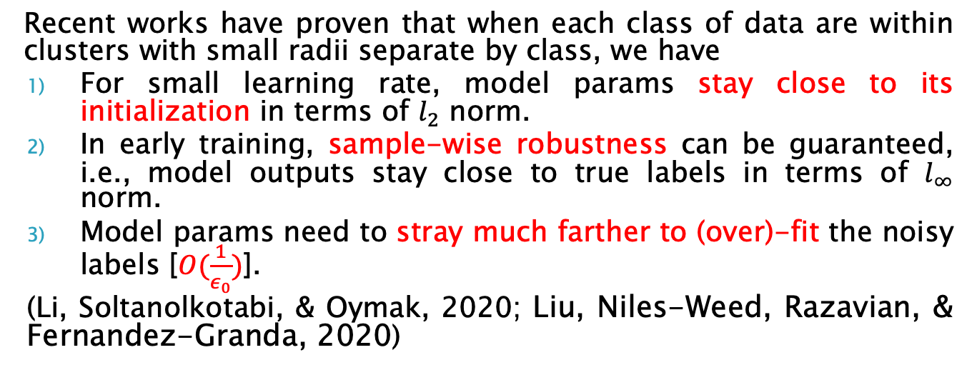
Robustness
Recent works have proven that when each class of data are within clusters with small radii separate by class, we have
For small learning rate, model params stay close to its initialization in terms of $l_{2}$ norm.
In early training, sample-wise robustness can be guaranteed, i.e., model outputs stay close to true labels in terms of $l_{∞}$ norm.
Model params need to stray much farther to (over)-fit the noisy labels [$O(\frac{1}{ε_{0}})$].
(Li, Soltanolkotabi, & Oymak, 2020; Liu, Niles-Weed, Razavian, & Fernandez-Granda, 2020)

Slide 4
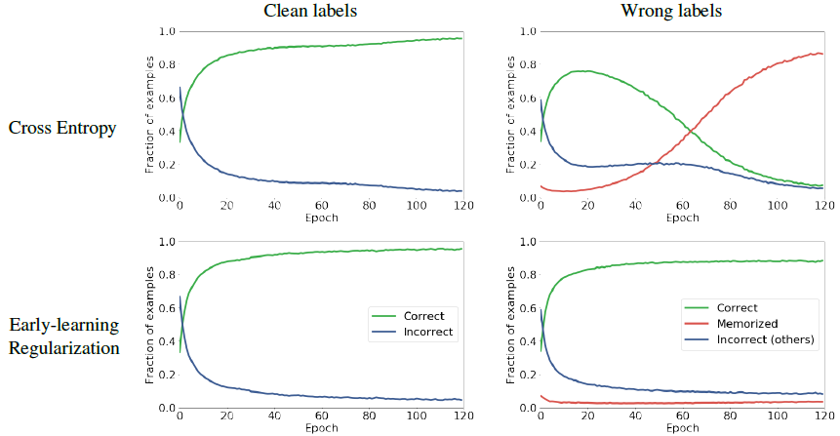
(Liu, Niles-Weed, Razavian, & Fernandez-Granda, 2020)

Slide 5
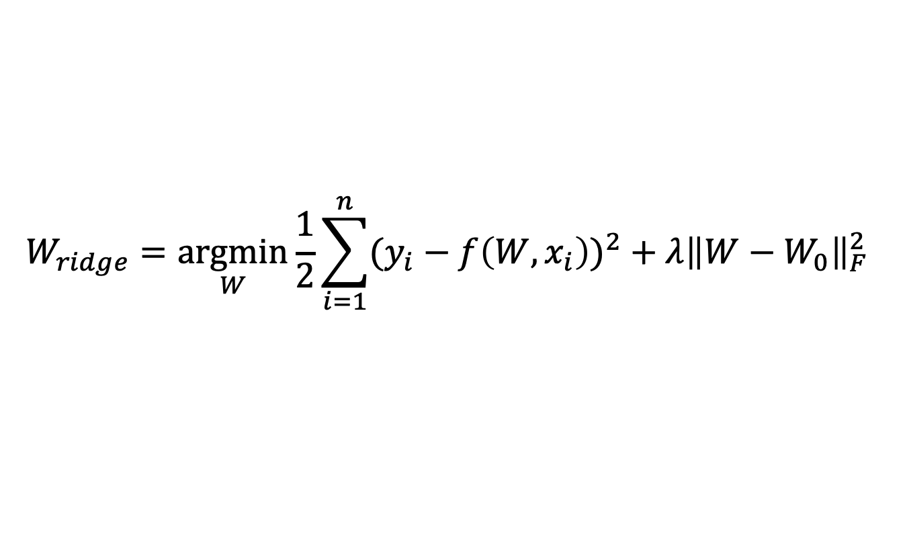
Inspired by Closeness to Model Initialization (Li, Soltanolkotabi, & Oymak, 2020)
$$W_{ridge}=\underset{W}{argmin}{\frac{1}{2}\sum_{i=1}^{n}{{(y_{i}−f\left(W,x_{i}\right))}^{2}}+λ{\left\|W−W_{0}\right\|}_{F}^{2}}$$

Slide 6
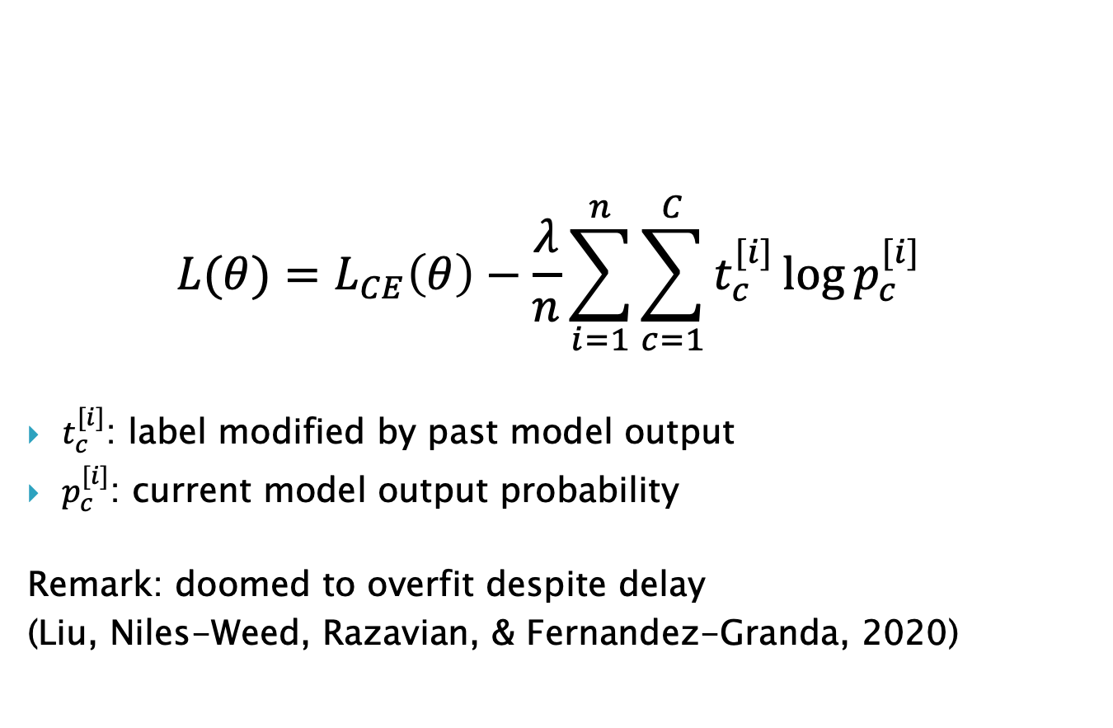
Kullback-Leibler Divergence
$$L(θ)=L_{CE}\left(θ\right)−\frac{λ}{n}\sum_{i=1}^{n}{\sum_{c=1}^{C}{t_{c}^{[i]}\log{p_{c}^{[i]}}}}$$
$t_{c}^{[i]}$: label modified by past model output
$p_{c}^{[i]}$: current model output probability
Remark: doomed to overfit despite delay
(Liu, Niles-Weed, Razavian, & Fernandez-Granda, 2020)

Slide 7
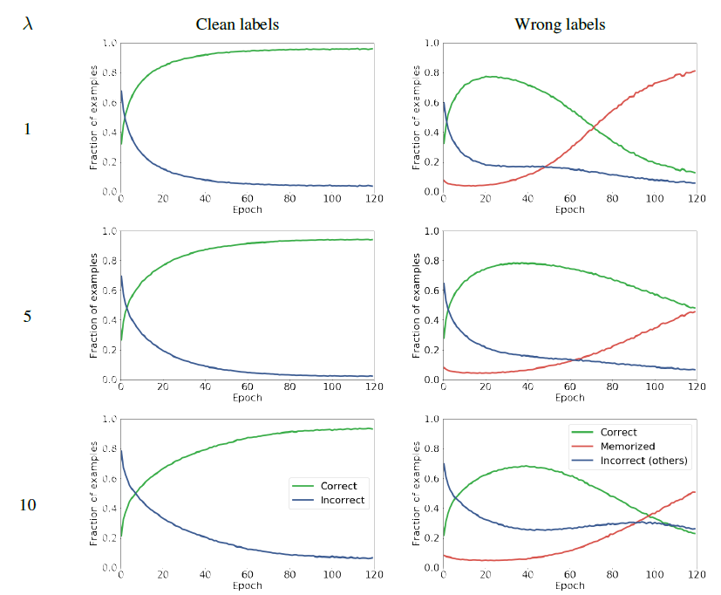
ResNet34 with KL on CIFAR10

Slide 8
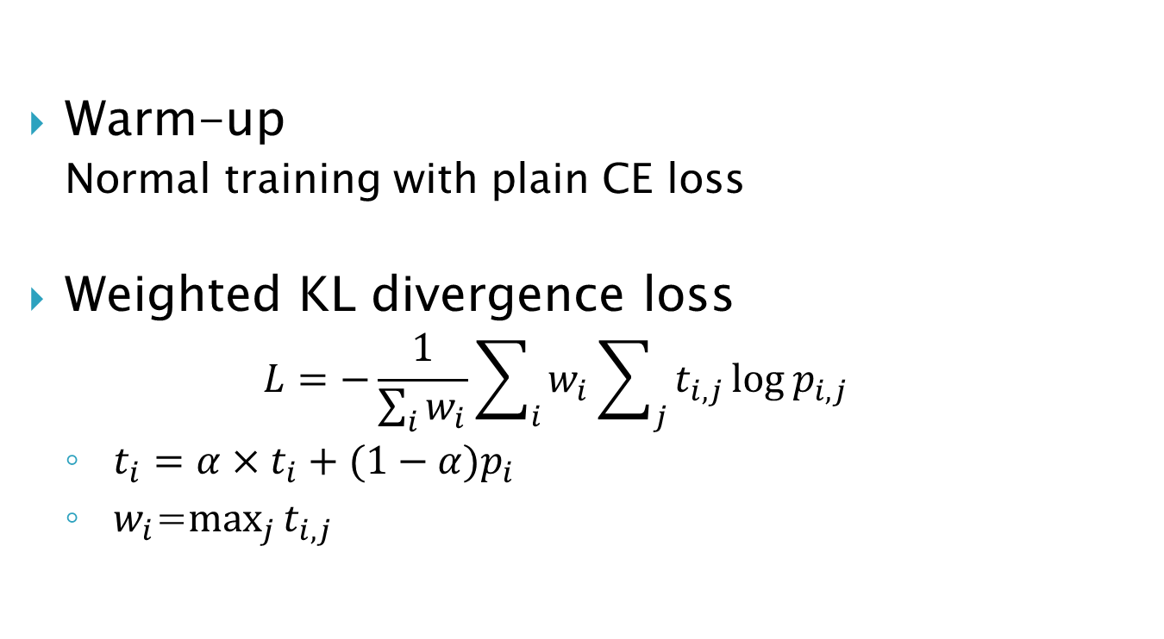
Self-adaptive Training (Huang, Zhang, & Zhang, 2020)
Warm-up
Normal training with plain CE loss
Weighted KL divergence loss
$$L=−\frac{1}{\sum_{i}{w_{i}}}\sum_{i}{w_{i}\sum_{j}{t_{i,j}\log{p_{i,j}}}}$$
$t_{i}=α×t_{i}+(1−α)p_{i}$
$w_{i}$=$\max_{j}{t_{i,j}}$

Slide 9
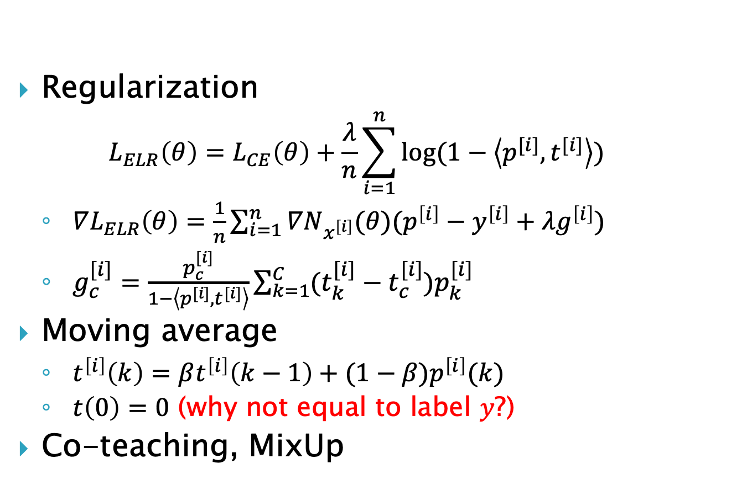
Early Learning Regularization (ELR) (Liu, Niles-Weed, Razavian, & Fernandez-Granda, 2020)
Regularization
$$L_{ELR}\left(θ\right)=L_{CE}\left(θ\right)+\frac{λ}{n}\sum_{i=1}^{n}{\log{(1−\left\langle p^{[i]},t^{[i]}\right\rangle )}}$$
$∇L_{ELR}\left(θ\right)=\frac{1}{n}\sum_{i=1}^{n}{∇N_{x^{\left[i\right]}}(θ)(p^{\left[i\right]}−y^{\left[i\right]}+λg^{\left[i\right]})}$
$g_{c}^{[i]}=\frac{p_{c}^{[i]}}{1−\left\langle p^{[i]},t^{[i]}\right\rangle }\sum_{k=1}^{C}{(t_{k}^{[i]}−t_{c}^{[i]})p_{k}^{[i]}}$
Moving average
$t^{\left[i\right]}\left(k\right)=βt^{\left[i\right]}\left(k−1\right)+(1−β)p^{\left[i\right]}(k)$
$t\left(0\right)=0$ (why not equal to label $y$?)
Co-teaching, MixUp

Slide 10
(Liu, Niles-Weed, Razavian, & Fernandez-Granda, 2020)

Slide 11
DivideMix Semi-supervised Learning
Warm-up
Gaussian mixed model
Split clean labels and noisy labels (unsupervised)
Co-guessing
Use params of the other model to guess clean probabilities
MixMatch

Slide 12
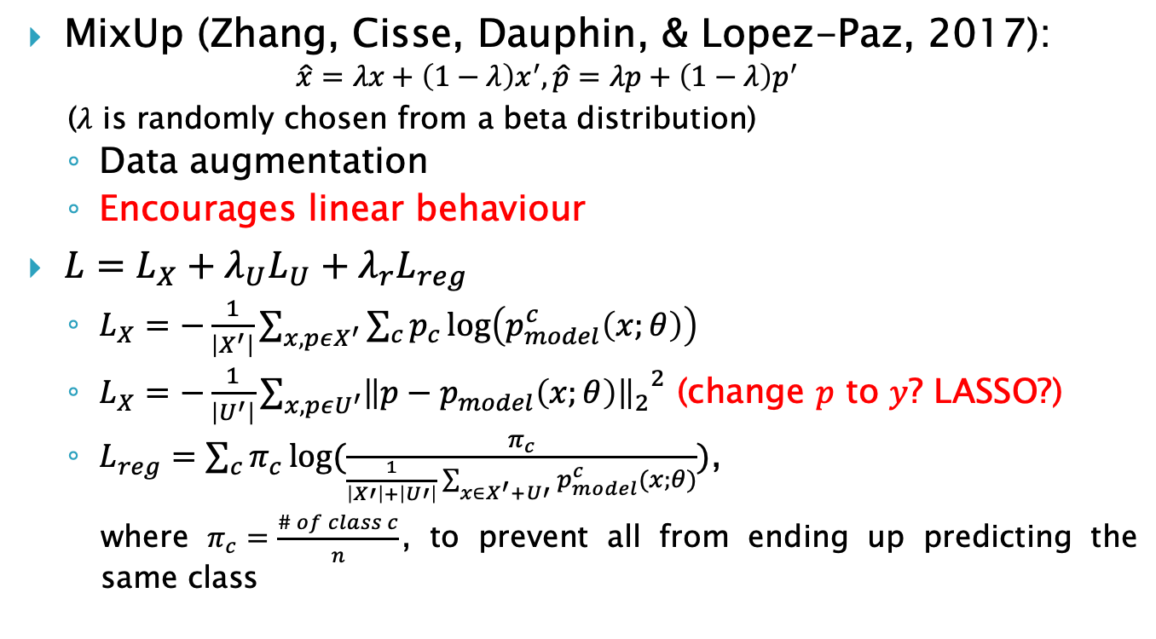
MixMatch (Berthelot, Carlini, Goodfellow, Papernot, Oliver, & Raffel, 2019)
MixUp (Zhang, Cisse, Dauphin, & Lopez-Paz, 2017):
$$\hat{x}=λx+\left(1−λ\right)x^{′},\hat{p}=λp+\left(1−λ\right)p^{′}$$
($λ$ is randomly chosen from a beta distribution)
Data augmentation
Encourages linear behaviour
$L=L_{X}+λ_{U}L_{U}+λ_{r}L_{reg}$
$L_{X}=−\frac{1}{\left|X^{′}\right|}\sum_{x,pεX^{′}}{\sum_{c}{p_{c}\log\left(p_{model}^{c}\left(x;θ\right)\right)}}$
$L_{X}=−\frac{1}{\left|U^{′}\right|}\sum_{x,pεU^{′}}{{{\left\|p−p_{model}\left(x;θ\right)\right\|}_{2}}^{2}}$ (change $p$ to $y$? LASSO?)
$L_{reg}=\sum_{c}{π_{c}\log{(\frac{π_{c}}{\frac{1}{\left|X′\right|+\left|U′\right|}\sum_{x∈X^{′}+U′}{p_{model}^{c}(x;θ)}})}}$,
where $π_{c}=\frac{\# of class c}{n}$, to prevent all from ending up predicting the same class

Slide 13
Improvement & Adaptation
Noise is sparse
No result on symmetric noise rate below 20% and asymmetric one below 10%
Longer warm-up
Less aggressive label correction
Huber-Lasso (Xu, Xiong, Huang, & Yao, 2014)
Asymmetric noise mostly one big class
Weighting (self-adaptive training)
Image noise detected in small defect class
MixUp
Ablation test
Hyperparams adjustment

Slide 14
References
Frénay, B., & Verleysen, M. (2013). Classification in the presence of label noise: a survey. IEEE transactions on neural networks and learning systems, 25(5), 845-869.
Li, M., Soltanolkotabi, M., & Oymak, S. (2020). Gradient descent with early stopping is provably robust to label noise for overparameterized neural networks. In International Conference on Artificial Intelligence and Statistics (pp. 4313-4324). PMLR.
Liu, S., Niles-Weed, J., Razavian, N., & Fernandez-Granda, C. (2020). Early-Learning Regularization Prevents Memorization of Noisy Labels. arXiv preprint arXiv:2007.00151.
Huang, L., Zhang, C., & Zhang, H. (2020). Self-Adaptive Training: beyond Empirical Risk Minimization. arXiv preprint arXiv:2002.10319.
Li, J., Socher, R., & Hoi, S. C. (2020). Dividemix: Learning with noisy labels as semi-supervised learning. arXiv preprint arXiv:2002.07394.
Berthelot, D., Carlini, N., Goodfellow, I., Papernot, N., Oliver, A., & Raffel, C. A. (2019). Mixmatch: A holistic approach to semi-supervised learning. In Advances in Neural Information Processing Systems (pp. 5049-5059).
Zhang, H., Cisse, M., Dauphin, Y. N., & Lopez-Paz, D. (2017). Mixup: Beyond empirical risk minimization. arXiv preprint arXiv:1710.09412.
Xu, Q., Xiong, J., Huang, Q., & Yao, Y. (2014). Robust statistical ranking: Theory and algorithms. arXiv preprint arXiv:1408.3467.

